Slide 1
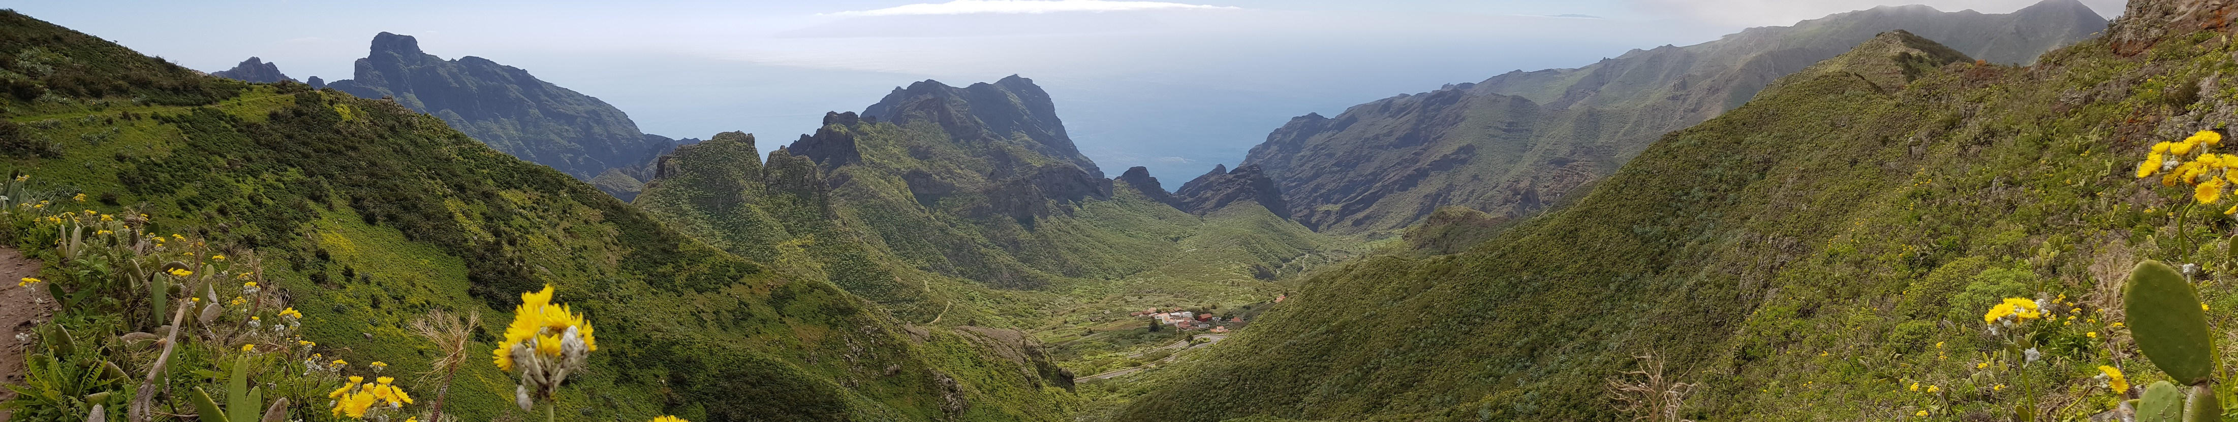
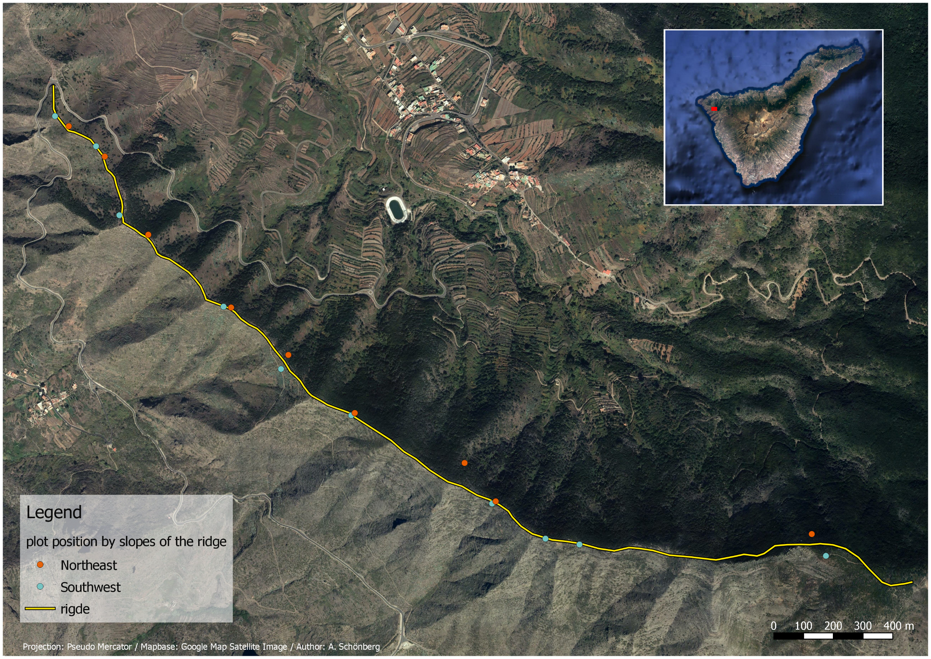
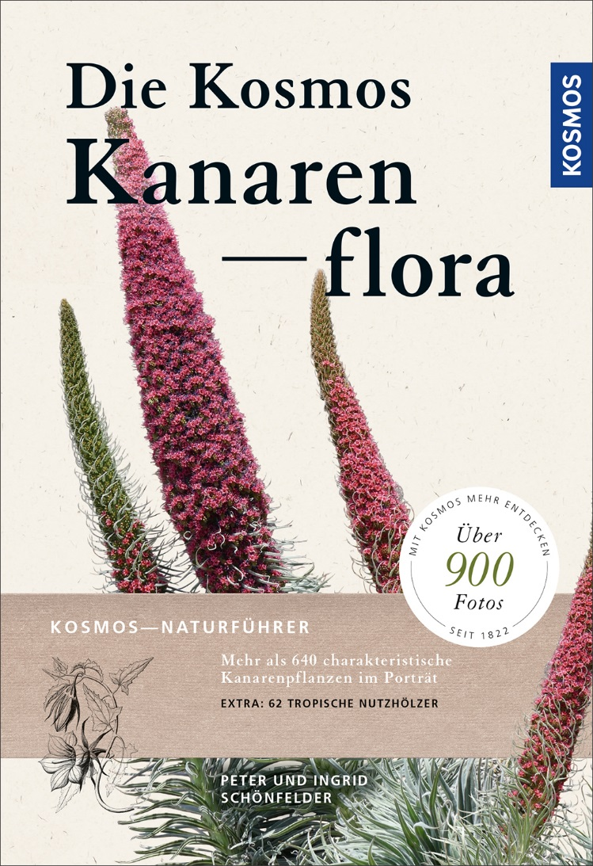
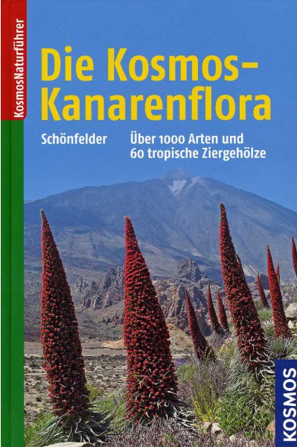
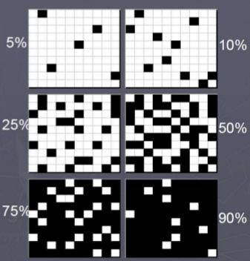

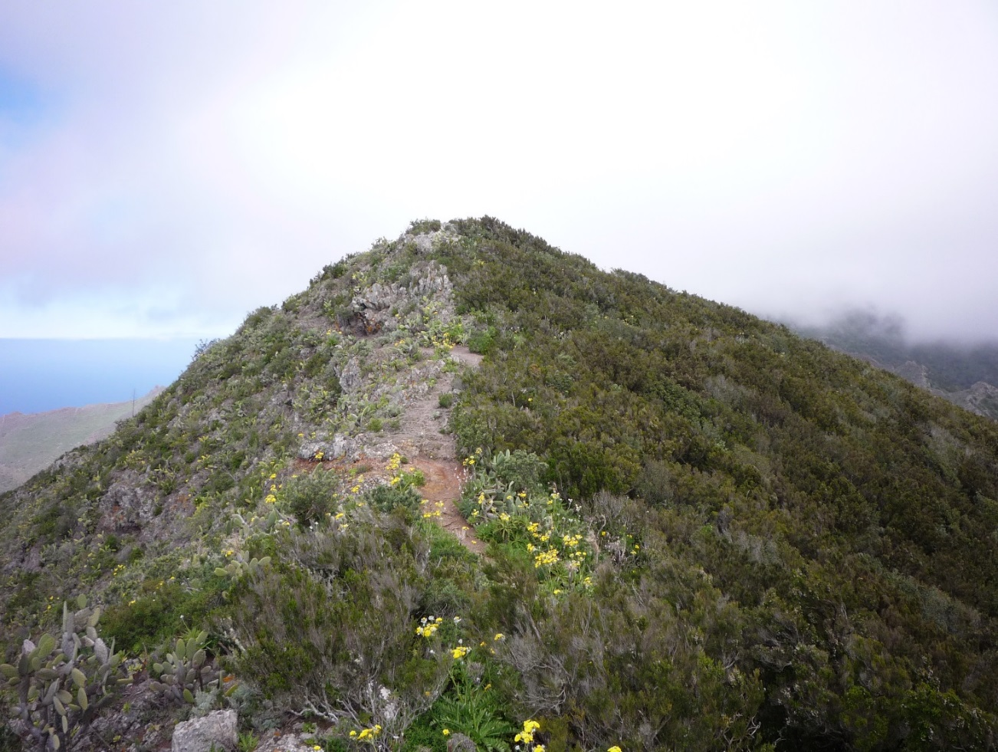
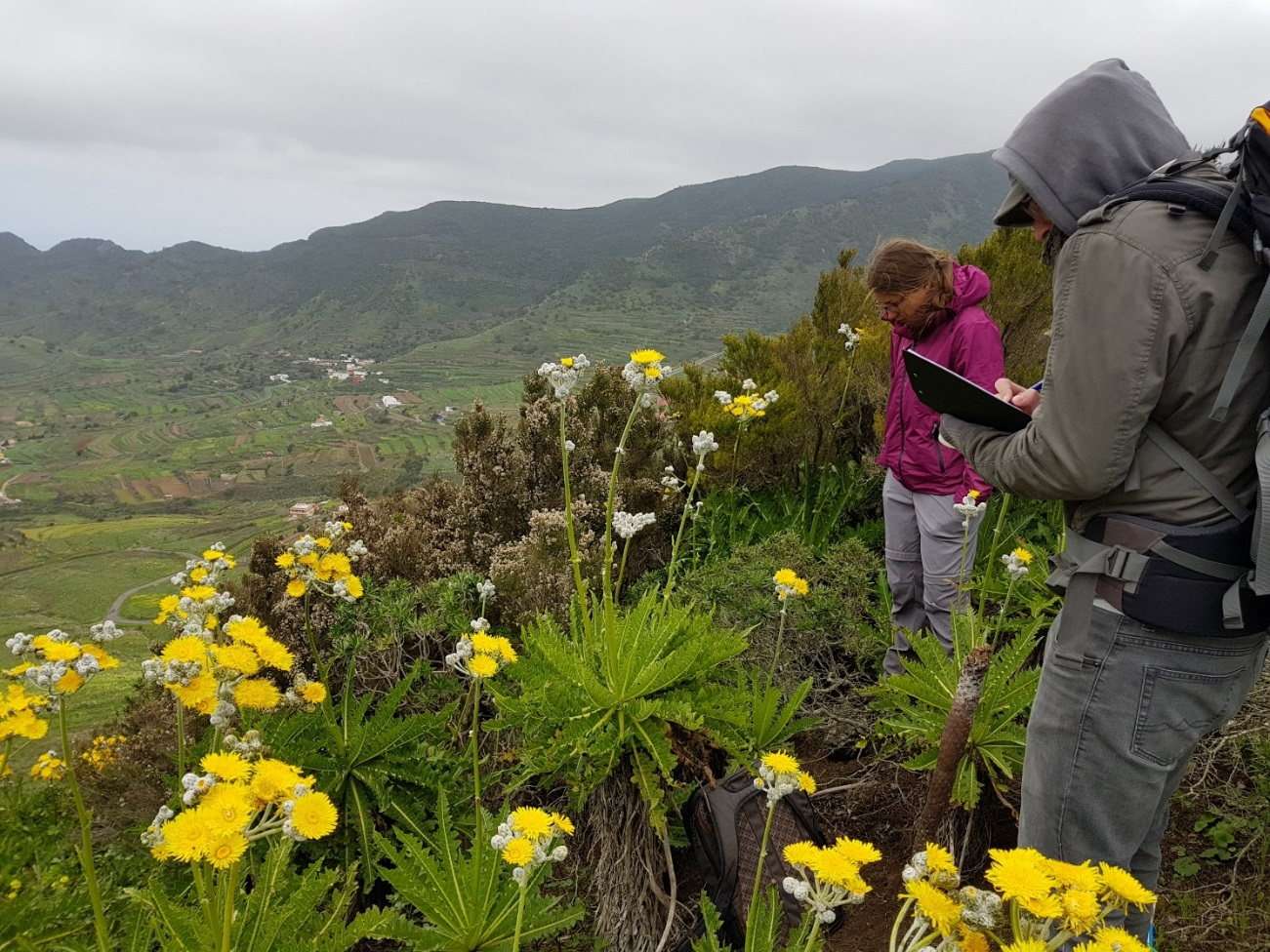
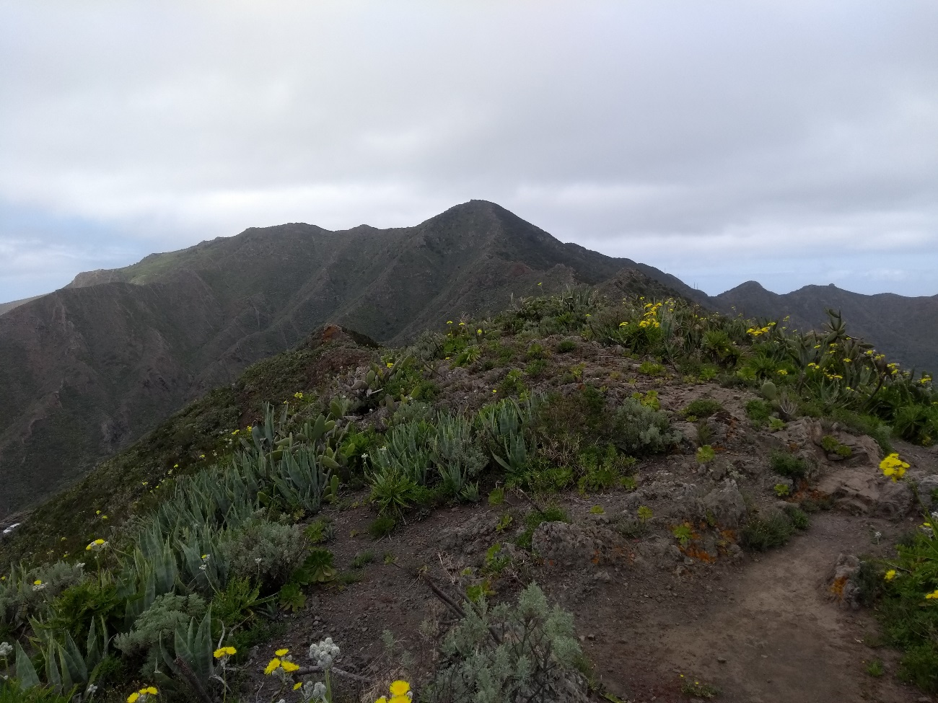
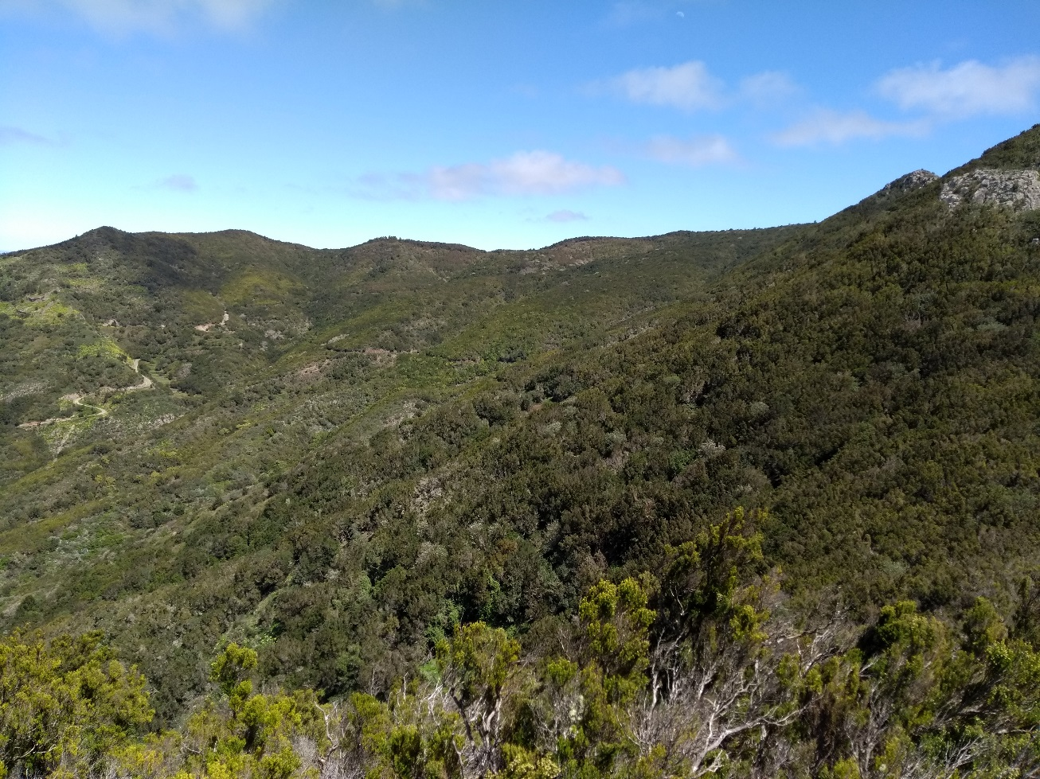
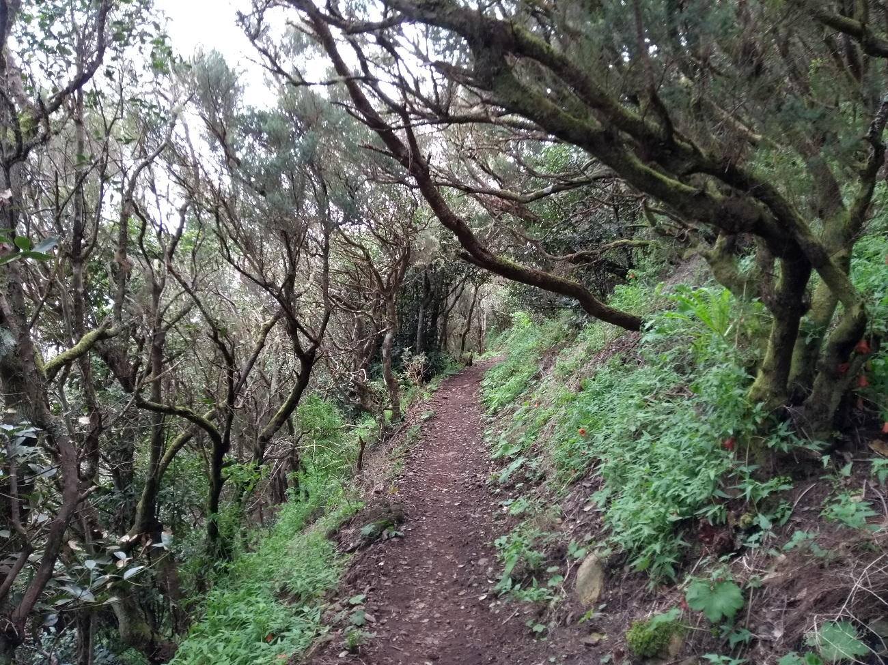
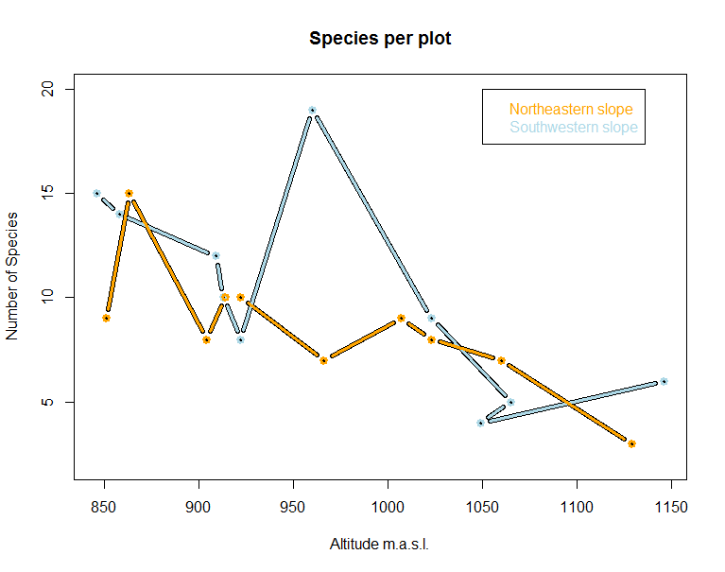
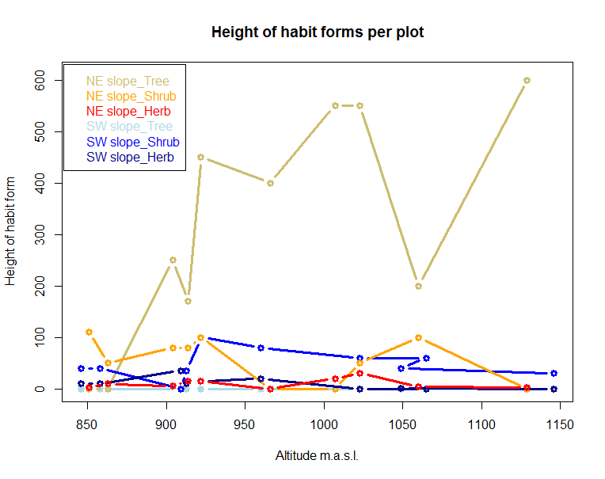
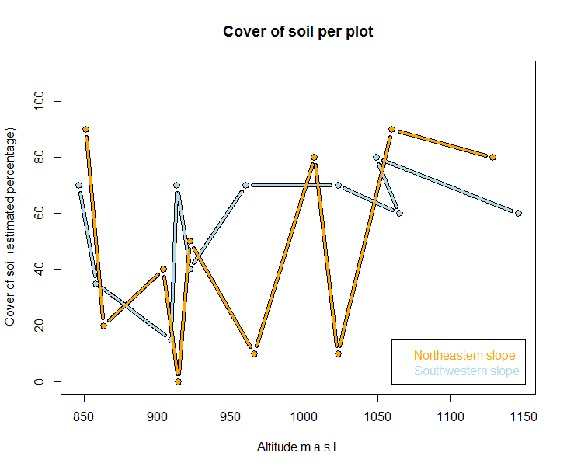
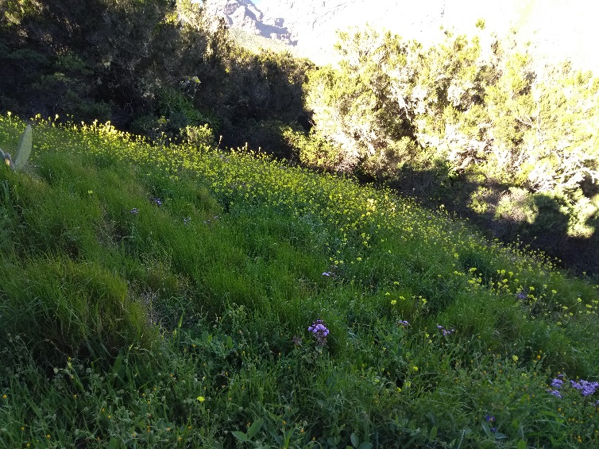
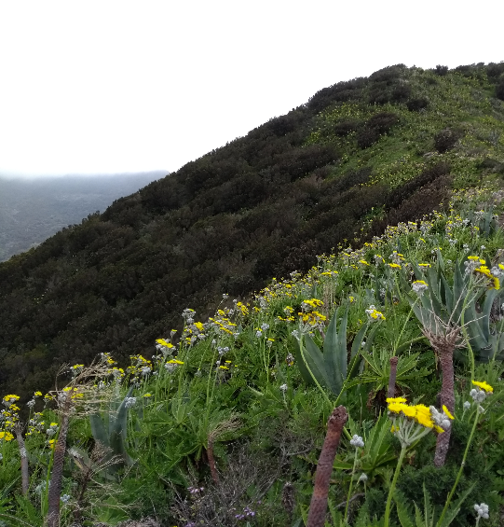
Philipps-Universität Marburg | FB 19 – Geographie | Geländepraktikum Teneriffa 2018
Tiziana Koch | Martin Monkos | Andreas Schönberg
Plot-based Vegetation Survey in the Teno Mountains of Tenerife
Are there differences in vegetation due to different slopes of a ridge in the Teno mountains?
INTRODUCTION | Differences in vegetation structures on the two slopes of a ridge in the Teno mountains of Tenerife were detected based on satellite images (Fig. 1). Especially the color and the density showed significant differences. Assumptions were that these are caused by different species compositions.
We hypothesized: There are differences in species compositions and plant communities on the two slopes of the ridge.
For testing our hypothesis plot-based vegetation surveys in the field on both slopes between the 22nd and the 24th of March 2018 were conducted. Subsequent we analyzed the collected data to prove the hypothesis.
STUDY AREA | The study area is located at Tenerife in the Teno mountains in the south of the village Las Portelas (Fig 1). The investigated ridge is about three kilometers long and its elevations are between 800 and 1100 m.a.s.l.. There are two main slopes – one slope is mainly south and west exposed, the other one north and east.
METHODS | For the investigation of the hypothesis a plot-based vegetation survey was appropriate. Essential was the creation of admission forms for a standardized data collection. Therefore, we chose 2x2 meter as plot size, because the relation of species and effort was hereby the best, all the representative species for the surrounding vegetation structure were within these plots. Ten plots on each slope were recorded. Species were determined using Kosmos Kanarenflora (Schönfelder & Schönfelder 2018) (Fig. 2 & 3) and <http://www.floradecanarias.com/>. To get a full assessment of the reachable sites along the whole ridge, we started at the bottom and climbed up. We set plots mostly alternating on the different slope sides and tried to distribute them evenly along (Fig. 1).
We collected and determined following data on the admission forms:
Location characteristics
Coordinates
Exposition
Estimated Inclination
Vegetation characteristics
Layered habit forms
Tree, Shrub, Herbs or Ground
Their estimated average height
Their estimated cover (Fig. 4)
Species
Scientific Species Name
Estimated average height of the specie
Estimated cover of the specie
Fig. 1: Map of study area in the Teno mountains with plot positions on two different slopes along a ridge.
Braun-Blanquet-Scale | Cover
r | Rare, 1-3 species, < 1 %
+ | > 3 species, < 1%
1 | 1 – 5 %
2 | 5 – 25 %
3 | 25 – 50 %
4 | 50 – 75 %
5 | > 75 %
Fig. 4: Braun-Blanquet-Scale with the cover assignment for estimating the cover of vegetation in the field (right) and visualization of exemplary coverage percentages (left).
Fig. 2
Fig. 3
For further statistical and descriptive analyses the admission forms were digitalized in excel format (view them using the QR-Code on the right). Based on Kosmos Kanarenflora (Schönfelder & Schönfelder 2018) the typical locations for each specie was added. We used R and Excel for cluster analysis, tabular displays, diagrams and summings of coverages, species and plot numbers.
Fig. 5: View on the ridge – Left: southwest slope; Right: Northeast slope.
Fig. 6: Data collection and determination in the field.
Fig. 7: Common view of lower southwest slope
Fig. 8: Erica arborea representing the common image of northeast slope.
Fig. 9: Pathway through the laurel forest of upper northeast slope.
RESULTS | Based on our collected data we are presenting our main results. In total 62 species were recorded. The highest covers in total over all plots had Erica arborea, Cistus monspeliensis and Sonchus acaulis. In contrast the most common species are Sonchus acaulis, detected on 13 out of 20 plots, Pericallis tussilaginis on 10, Erica arborea and Cistus monspeliensis respectively on 9. For inspecting the indicator species and their typical locations for each of the slopes a table was established (Fig. 10). The number of species per plot is almost even on both slopes and has a slight decrease with a higher altitude (Fig. 11).
Furthermore a cluster analyses using the Bray-Curtis-Indicator was implemented. The result clearly assigns that there are two slopes with distinctive characteristics and plant compositions so that the method of categorizing the plots in two cluster (Custer 1 and Cluster 2) were sufficed (Fig. 12). Only exceptions were a unique plot with meadow (Fig. 13) and one with plenty of Sonchus acaulis (Fig. 14) which were assigned to the wrong cluster. We assume that these plots were heavily disturbed by human impact.
There is a significant difference in habit form heights on both slopes (Fig. 15). While the Southwestern slope has no tree layer, the Northwestern slope includes a tree layer with an increase of height and altitude (Fig. 15). The shrub and herb layers are not showing clear discrepancies with higher altitude (Fig. 15). As the soil cover of the Northwestern slope is changing repeatly, the other slope is showing more continuity (Fig. 16).
Fig. 11
Fig. 15
Fig. 16
Fig. 13 & 14: Exceptions of categories in cluster analyses. Meadow at Southwestern slope and Sonchus acaulis at Northeastern slope.
Fig. 12
Slope Southwest |  |  | Slope Northeast
Species | Amount of plot appearances | Locations | Species | Amount of plot appearances | Locations
Aeonium ciliatum | 70 % | Rocky locations until forest regions | Pericallis tussilaginis | 90 % | Shadowed-wet rocks and walls, from coast until laurel forests in the north
Cistus monspeliensis | 60 % | Succulent scrub and forests, rocky slopes and agricultural terraces' edges | Erica arborea | 80 % | Laurel forest, northexposed pine forests
Sonchus acaulis | 60 % | In warmer parts of pine forest and compensation communities | Sonchus acaulis | 70 % | Succulent scrub and forests, rocky slopes and agricultural terraces' edges
Echium aculeatum | 50 % | succulent scrub, locally until pine forest | Galium aparine | 60 % | Laurel forest and cultivated land
Micromeria varia | 50 % | succulent scrub until forest regions | Drusa glandulosa | 50 % | Laurel forest, also lower at fresh locations, also at wet waysides
Phagnalon purpurascens | 50 % | succulent scrub, locally until pine forest | Fumaria coccinia | 50 % | Rocky, open locations and waysides
Aeonium sedifolium | 40 % | Dry forest locations | Cistus monspeliensis | 30 % | In warmer parts of pine forest and compensation communities
Anagallis arvensis | 40 % | - | Canarina canariensis | 30 % | Laurel forest
Bituminaria bituminosa | 40 % | Waysides, weedy meadows, rocks, from succulent scrubs until subalpine levels | Ferula linkii | 30 % | Open locations of the upper succulent scrub until subalpine regions
Kleinia neriifolia | 40 % | succulent scrub | Ilex canariensis | 30 % | Myrica-Erica scrubs and laurel forest, locally until pine forests
Fig. 10: Table of indicator species, amounts of plot appearances of each species and typically locations of species. Only top ten species per slope were considered.
CONCLUSION | With our field work we could confirm our hypothesis, that in our study area there are differences in species compositions and plant communities on the two slopes of the ridge proved by a cluster analysis. Further the statistical analysis generated additional proves. We assume that the differences are due to different climate caused by sun exposed position and wind direction and the following humid conditions. In summary significantly different vegetation communities can be conformed for both slopes with exclusions due to assumed human impact. The conclusion only apply for the ridge and therefore the upper slopes.
References:
González, M. L. G. (2018): Flora Vascular de Canarias. <http://www.floradecanarias.com/>.
Schönfelder, P. & I. Schönfelder (2018): Die Kosmos Kanarenflora, Kosmos, 4. Aufl., Stuttgart.
References of external figures:
[2] <https://www.kosmos.de/buecher/ratgeber/natur/pflanzen/9413/die-kosmos-kanarenflora>.
[3] <http://www.architectura.nl/natural-history/plants/die-kosmos-kanarenflora.html>.
[4] Changed on basis of <https://fr.slideshare.net/GroupeProConseil2015/essais-de-ray-grass-2013>.

